Slide 1

Email Subject line Generation
Group 16
Paramasivan Dorai
Jagadeesh Vana
Arun Ganireddi
Naga Maruthi Vangara

Slide 2


Agenda
Problem Description
Dataset Description and Visualization & Preprocessing
Models & Zero Shot Testing
Training, Validation & Application

Slide 3

Problem Description
The first task is to generate concise email subject lines from the body of the email. This involves identifying the most salient sentences and summarizing them into a few words.
Fine tuning any GPT2 variant to generate the most suitable subject line for any given email
The second task is to train a domain-specific GPT-variant model that can answer questions specific to the AIML course. This task involves building a novel, relevant dataset for the task and fine-tune a GPT-variant model.

Slide 4

Dataset
Analysis and Visualization

Slide 5
Data Analysis
Email Subject Generation
Enron email dataset from Github AESLC.
Annotated Enron Subject Line Corpus.
dev, test, and train email datasets.
Sizes of train/dev/test splits: 14,436 / 1,960 / 1,906
Average email length: 75 words
Average subject length: 4 words
Dev and Test contains 4 subject lines
AIML Question and Answering
This dataset has been handcrafted by all the teams in the cohort
Two Datasets
Dataset 1 – train/dev/test splits: 1316/80/120
Dataset 2 – train/dev/test splits: 1979/248/249
Average Answer length in train dataset
Average Answer length in test dataset

Slide 6
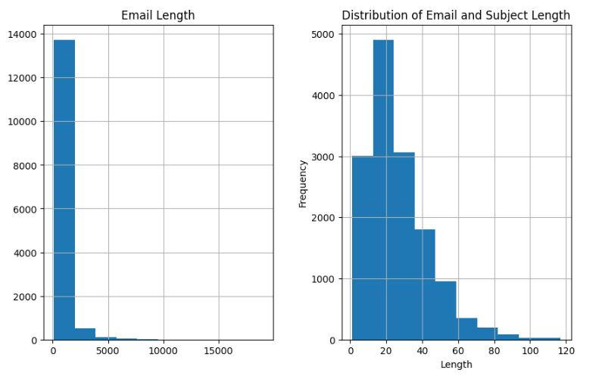
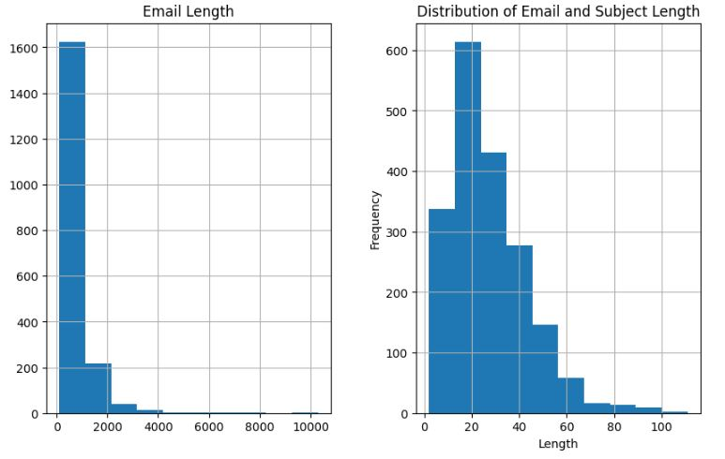
Data Visualization
Train Data Set
Test Data Set

Slide 7
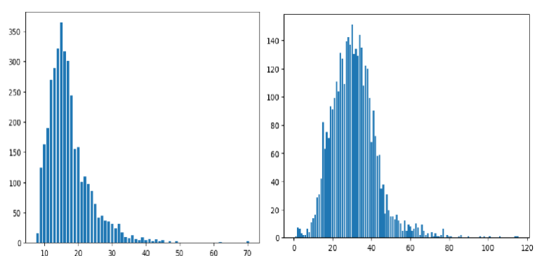
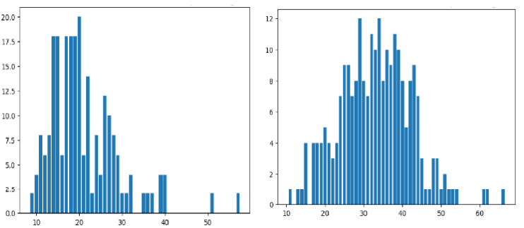
Data Visualization
Train Data Set
Test Data Set
Question Lengths
Question Lengths
Answer Lengths

Slide 8
Preprocessing
Email Subject Generation
Space delimited reports - Removed multiple spaces with single space.
Delimiters in emails - Removed non-word and non-space characters.
Extracted all the subject lines for scoring
More than 95% emails body has less than 2500 characters.
Trim the first 2500 characters of the email body
AIML Question and Answer
The preprocessing in task 2 primarily involved in formatting the training dataset to an appropriate prompt format – we used 2 prompting formats GPT style and Alpaca style prompting

Slide 9

Models and Training

Slide 10
Models – Task 1
GPT2
We started with this model
Distill GPT2
To overcome space and memory issues, we used this model
T5 Small
Relatively Smaller to handle
Relatively smaller to handle
Space and Memory issues
BART
Encoder - Decoder Model
Decoder only model
Decoder only model
Encoder - Decoder Model

Slide 11
Zero Shot Testing – Email Subject
Observation
For Example:
Email Body: Hi Judy How are you I sent Ingrid an email and she told me that you are still at Enron Thats good I tried to call you at work but the girl that answered the phone said that you were on vacation today How are the kids and Rob I think about you all of the time Ingrid told me that she told you that I got married It isnt Tod it is James Johnson that I dated in high school We could have saved each other a lot of heart ache and just stayed together He is really sweet He has 3 boys so now there are 4 boys in my house I am real outnumbered But its fun Are you still working parttime or fulltime There is so much to talk about we need to get together for lunch or something Maybe we could meet somewhere one day let me know My phone numbers are Home 2818073186 and work 7132154473 And now you have my email address Talk to you soon Laurie
Subject Line: Latest Marketing List
Generated Summary: Laurie writes to her ex-boyfriend from high school. She wants to know if he is still at Enron. She also wants to meet up for lunch.
Zero Shot testing in all the models
Common trend - long subject lines.
Focused on hyper parameters such as
length_penalty,
max_new_tokens,
max_length
min_length
num_beams (relevancy)

Slide 12
Observation & ROUGE Scores
Observations
Encoder-Decoder models performed better as they used the context (email body) to generate the subject line
The GPT variant generated innovative subject lines therefore the ROUGE scores were poor
Understanding - Architecture and pre-training tasks of BART and T5 made them perform better
Model | Rouge 1 | Rouge 2 | Rouge L
BART | 0.3006580658920587 | 0.15170335761446782 | 0.2884998344468854
T5 Small | 0.27557781919299007 | 0.13223830150238886 | 0.26705263028546283
Distil GPT2 | 0.10658709214367193 | 0.041839523780108655 | 0.10234448377437692
GPT2 | 0.015072665203599737 | 0.005770499929776675 | 0.013233120524232568

Slide 13
Models – Task 2
GPT2
Gemma 2
Llama 2
Unsloth framework
Llama 3
Decoder Only
Decoder Only
Decoder Only
Decoder Only
PEFT - LORA
7 Billion parameters
8 Billion parameters
124 million parameters
2 Billion parameters
PEFT - LORA
Trainable parameters 524 million
Trainable parameters 262 million
Trainable parameters 525 million
Trainable parameters 124 million
Pre-trained tokens – 10B
Pre-trained tokens – 2T
Pre-trained tokens – 2T
Pre-trained tokens – 10T+

Slide 14
Zero Shot Testing – Q & A
Observation
What is Alexnet?
Alexnet is a web application that allows you to create and manage your own websites. It is a web application that allows you to create and manage your own websites. It is a web application that allows you to create and manage your own websites
What is Neural Network?
Neural networks are a type of neural network that is used to process information from a computer. They are used to process information from a computer and then process it back into a computer. Neural networks are used to process information from
Zero Shot testing in all the models
Hallucinations and repeating answers noticed before fine tuning
Focused on hyper parameters such as
Prompt structure
Max New Tokens / Max Length parameters

Slide 15
Observation & ROUGE Scores
Observations
Training Dataset tokens – 174K
Generative Models
Dataset 2 scores (the Dataset 1 scores are comparable)
Model | Rouge 1 | Rouge 2 | Rouge L
GPT2 | 0.36956118319733666 | 0.16392918775217533 | 0.3127743307192723
Llama 2 | 0.3912341324778206 | 0.18069427233839613 | 0.3157717606974474
Gemma 2 | 0.455100963377403 | 0.22904456388130273 | 0.38447970761053407
Llama 3 | 0.48342827227660445 | 0.2631626190945965 | 0.41491957225471765

Slide 16



Summary
It was a great learning experience fine tuning these transformer models to perform a specific task. The nuances of encoder-decoder vs decoder-only models and how it could influence the performance was a great learning experience.
There were engineering issues that these large models caused and we had to figure out ways to deal with them along the way. This task has increased our understanding multifold.
Email subject line Generation

Slide 17

Thank you

Slide 18
Appendix

Slide 19

Gradio Application and Human Evaluation

Slide 20
Application
Initially used a simple Colab notebook Gradio for review
Final version of the application published to Hugging Face Gradio Spaces
Larger models, where we had to use quantization, had to be on colab
Model | Repo Folder | Gradio App
BART | Email_Subject_Generation_BART | https://huggingface.co/spaces/paramasivan27/Email_Subject_Generation_BART
T5 Small | Email_Subject_Generation_T5Small | https://huggingface.co/spaces/paramasivan27/Email_Subject_Generation_T5Small
GPT2 | AIML_QandA_finetuned_gpt2 | https://huggingface.co/spaces/paramasivan27/AIML_QandA_finetuned_gpt2

Slide 21
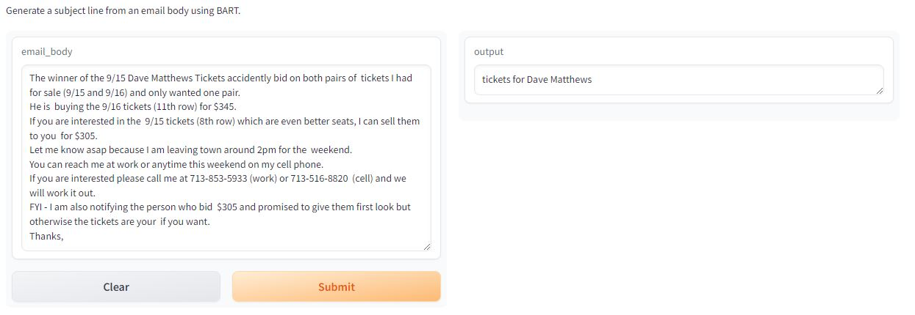
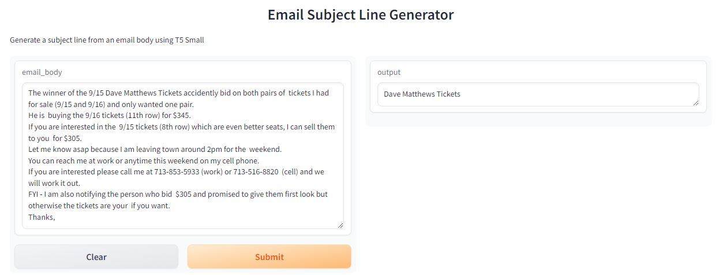
Human Evaluation

Slide 22
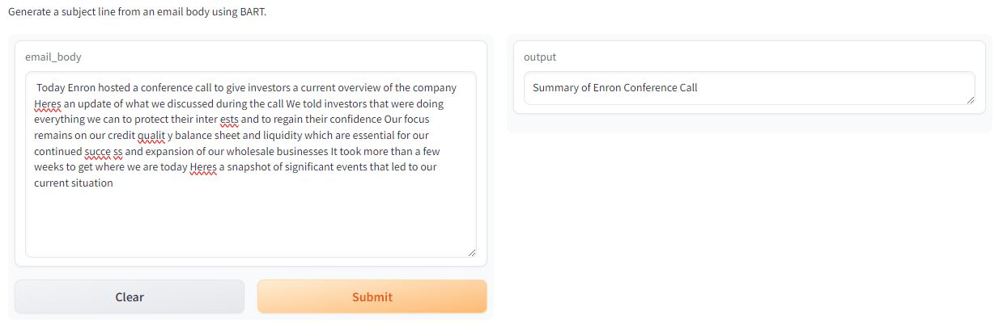
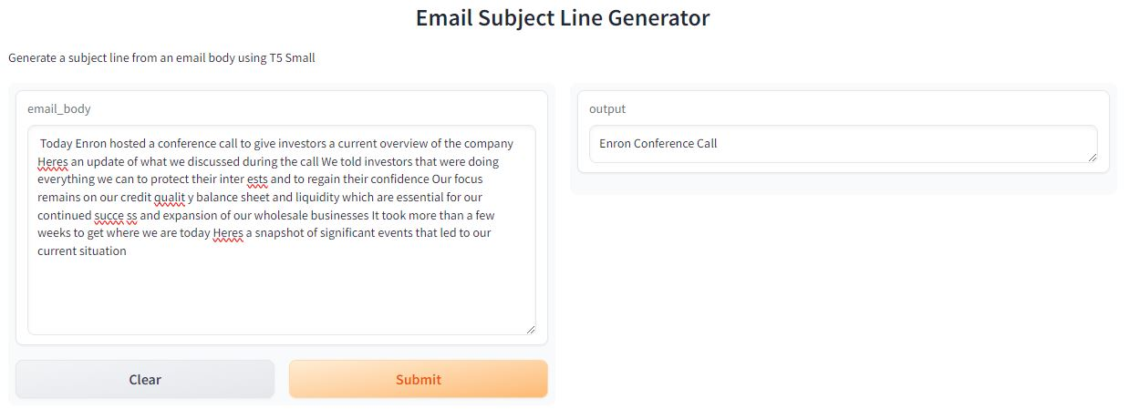
Human Evaluation

Slide 23
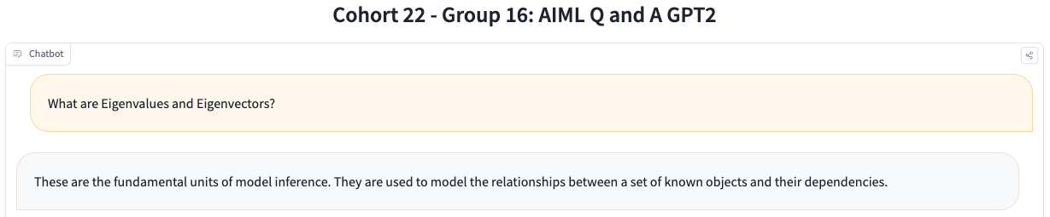
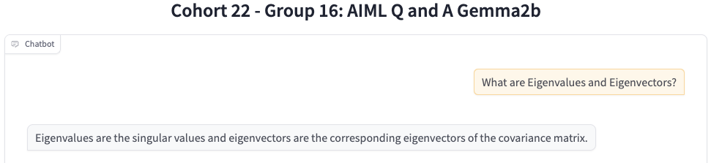
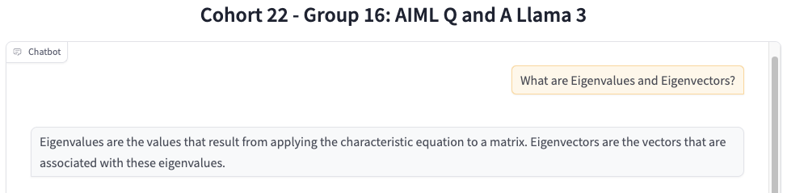
Human Evaluation

Slide 24
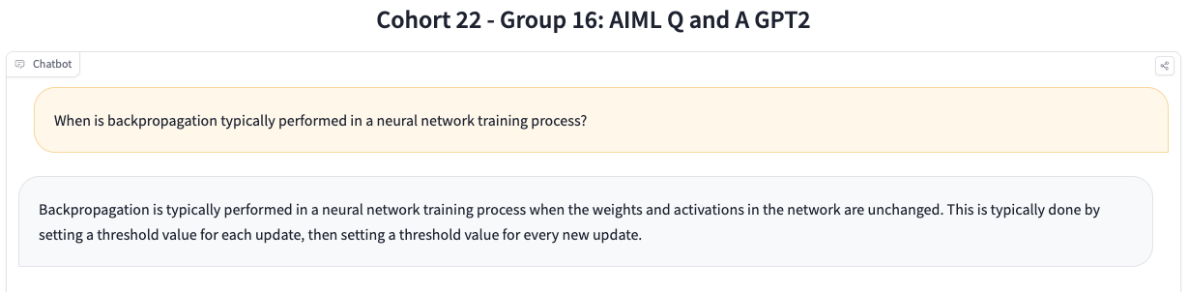
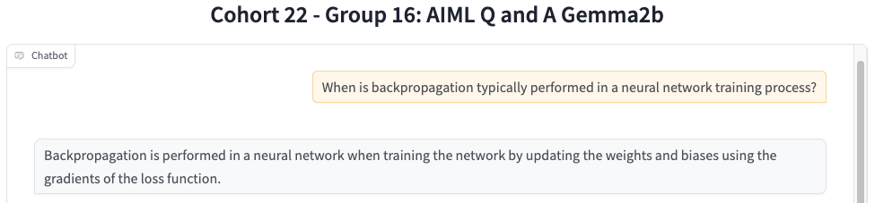
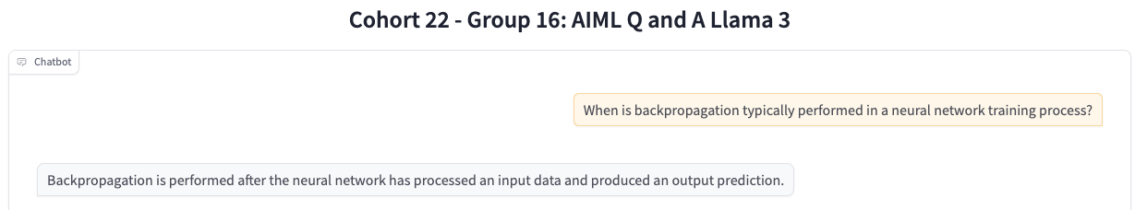
Human Evaluation

Slide 25
Specifics of Training & Git Details

Slide 26
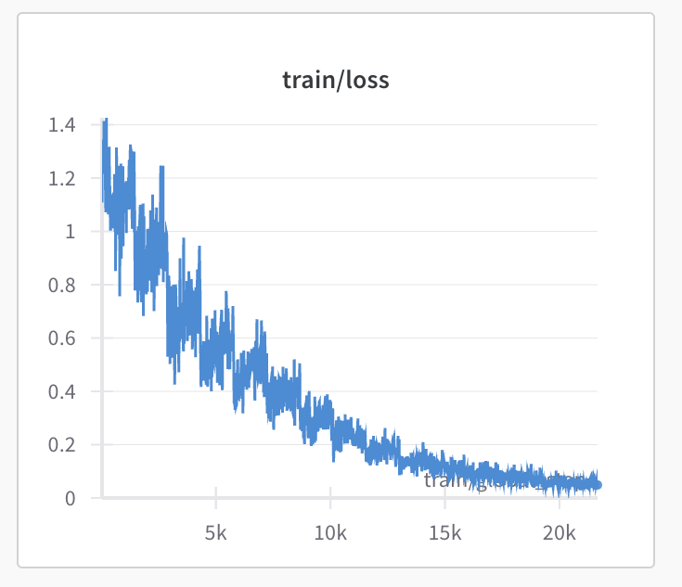
Training – Email Subject
We fine tuned and tested the four models.
We started with Decoder only models like GPT2, DistilGPT2, etc
Though these models generated a subject line - they were innovative and did not seem to consider the email body
On further reading and understanding , we started with BART and T5 models (encoder-decoder models)
We could get good Rouge score with these two models

Slide 27
Training – Email Subject
GPT2
Distill GPT2
T5 Small
BART
Model Weights
Model Weights
Model Weights
Model Weights
https://huggingface.co/paramasivan27/bart_for_email_summarization_enron
https://huggingface.co/paramasivan27/gpt2_for_email_summarization_enron
https://huggingface.co/paramasivan27/distilgpt2_for_email_summarization_enron
https://huggingface.co/paramasivan27/t5small_for_email_summarization_enron
Unrelated Subject lines
Low ROUGE Scores
Unrelated subject lines
Low ROUGE Scores
Better subject lines
Good ROUGE Scores
Good subject lines
Best ROUGE Scores

Slide 28
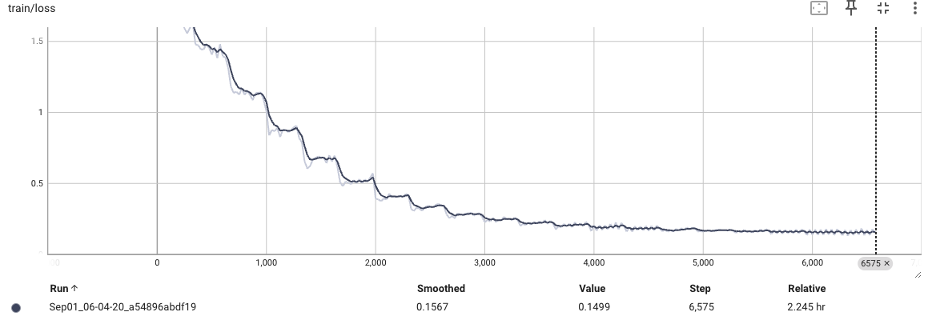
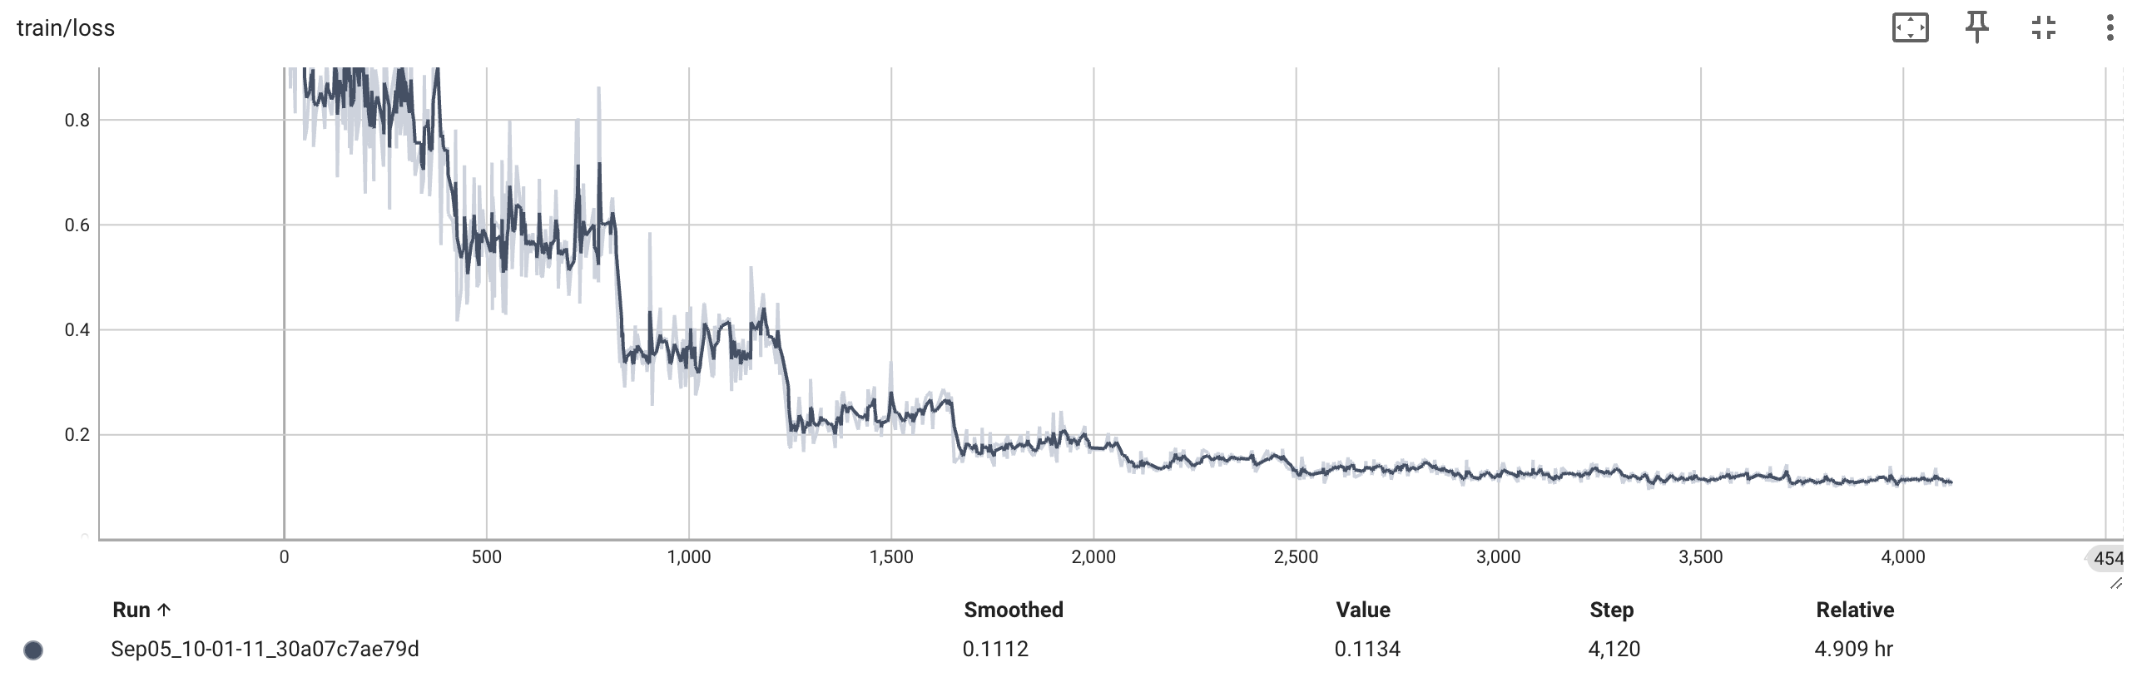
Training – Q&A
We fine tuned and tested the four models.
We initially started with BERT and T5 models.
We could not get relevant answers using these models
Quickly pivoted to Generative models as the problem statement recommended
We could get consistent and relevant responses

Slide 29
Training – Q&A
GPT2
Llama 3
https://huggingface.co/paramasivan27/gpt2_for_q_and_a
Model compression was not required
Model compression was required
Model compression was required
Model compression was required
Llama 2
Gemma 2
20 Epochs
20 Epochs
20 Epochs
https://huggingface.co/paramasivan27/Llama-2-7b-for_q_and_a
20 Epochs
https://huggingface.co/paramasivan27/llama-3-8b-bnb-4bit
https://huggingface.co/paramasivan27/Gemma_2b_it_q_and_a

Slide 30
GitHub Repo
All Training Data, Notebooks and Gradio App is present in the following GIT Repo
https://github.com/ch22group16/capstone-GenAI/tree/main

